Slide 1
Sample Design
IVU Model Development Training Course
June 2014
1
Notes:
1

Slide 2
Agenda
Scorecard development process
Model development process @ nab
Choose the performance window
Choose the sample window
Sample exclusions
Design the good bad definition
Segmentation

Slide 3
Neither sophisticated software nor statistical techniques can overcome the inherent limitations of the raw data that goes into them.
McNab and Wynn (2003)

Slide 4
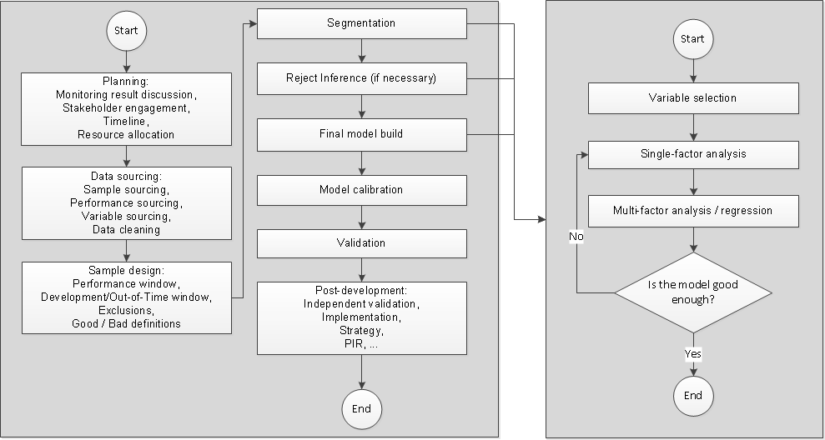
Scorecard development process
Full process
Modelling process

Slide 5
Model development process @ NAB
Stakeholder engagement
Project Scoping
Business Case (Statement of work)
Project Definition Document
Detailed Project Plan
3. DEVELOP
Data Document
Final Model Document
Technical Specification Document
PIR Packs
1. INITIATE
2. DEFINE
4. DOCUMENT
Stakeholder engagement
Project Scoping
Business Case (Statement of work)
Project Definition Document
Detailed Project Plan
Segmentation
Cluster Analysis
Single Factor Analysis
Multi Factor Analysis
Reject Inference
Validation
Impact Analysis
Data Extraction
Data Quality
Good Bad Definition
Sample Design
5. GOVERNANCE
6. SYS BUILD
7. REVIEW
Independent Validation Report (IVU)
Model Approval / Endorsement from relevant stakeholders
Strategy Manager
Testing
Champion/ Challenger Roll Out
PIR Process
PIR of Development
Dependency – outside model development team
Dependencies lie across Retail Model Development and external customers

Slide 6
Why sample is so important
Scorecards are developed using the assumption that “future performance will reflect past performance”. In other words, scorecards are trained on data from the past but are used to predict the data in the future
The real-life data is often imperfect, in quantity as well as quality
Garbage in, garbage out (GIGO): computers will unquestioningly process unintended, even nonsensical, input data and produce undesired, often nonsensical, output

Slide 7
Key parameters in sample design
The level of modeling: application vs account vs customer?
The performance window
The sample window
Exclusions
Good bad definition

Slide 8
Determine the performance window
Performance window is the time window given to monitor the performance of the accounts in order to determine the prediction class (target)
Loans don’t turn bad right away after they are opened nor do they turn bad at the same pace
In Basel definition, the performance window is normally 12 months and is consistent across different portfolios
In operational scorecards, the businesses have the flexibility to decide the appropriate length themselves
The period should be sufficient so that the most risky customers turn delinquent within and customers survive the period are highly likely to stay good
Revolving loans (e.g. credit cards) < term loans (e.g. mortgage). The window length grows with the term length of the loans (e.g., mortgage > personal loan).
Application scorecards > account management scorecards > collection scorecards

Slide 9
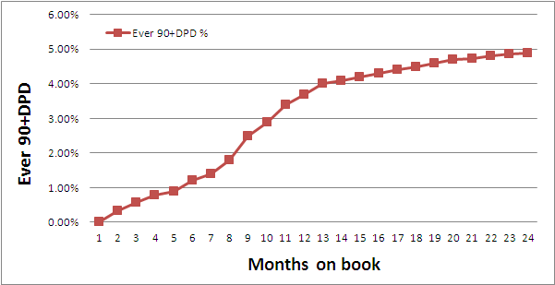
Vintage (cohort) analysis
90+DPD | Month on book
Open month | 1 | 2 | 3 | 4 | 5 | 6 | 7 | 8
Jan-14 | 0% | 0.32% | 0.87% | 1.40% | 2.30% | 3.42% | 4.30% | 5.60%
Feb-14 | 0% | 0.37% | 0.77% | 1.20% | 2.10% | 3.53% | 4.11%
Mar-14 | 0% | 0.42% | 0.84% | 1.35% | 2.50% | 3.27%
Apr-14 | 0% | 0.41% | 0.82% | 1.42% | 1.89%
May-14 | 0% | 0.38% | 0.80% | 1.28%
…
The vintage analysis essentially calculates the cumulative bad rate. It shows how quick does a (bad) account reaches 90DPD (standard bad definition).
At a certain point, the cumulative bad rate becomes stable, which means no new bad account is developed. We say the cohort matures.
Mature cohorts can minimize the chances of misclassifying bad samples as good, which leads to under estimation of the true risk
In real life, cohorts rarely mature fast enough!
Trade-off must be chosen between sufficient time to mature and the “freshness” of the sample

Slide 10
Vintage (cohort) analysis
90+DPD | Month on book
Open month | 1 | 2 | 3 | 4 | 5 | 6 | 7 | 8
Jan-14 | 0% | 0.32% | 0.87% | 1.40% | 2.30% | 3.42% | 4.30% | 5.60%
Feb-14 | 0% | 0.37% | 0.77% | 1.20% | 2.10% | 3.53% | 4.11%
Mar-14 | 0% | 0.42% | 0.84% | 1.35% | 2.50% | 3.27%
Apr-14 | 0% | 0.41% | 0.82% | 1.42% | 1.89%
May-14 | 0% | 0.38% | 0.80% | 1.28%
…
The vintage analysis essentially calculates the cumulative bad rate. It shows how quick does a (bad) account reaches 90DPD (standard bad definition).
At a certain point, the cumulative bad rate becomes stable, which means no new bad account is developed. We say the cohort matures.
Mature cohorts can minimize the chances of misclassifying bad samples as good, which leads to under estimation of the true risk
In real life, cohorts rarely mature fast enough!
Trade-off must be chosen between sufficient time to mature and the “freshness” of the sample
How long does this example mature?

Slide 11
Determine the sample window
Sample window is the time frame from which modelling samples will be selected
The sample window should not include “abnormal” periods, so the sample used for development is in line with normal business periods, conforming the assumption that “the future is like the past”
The sample window should be large enough so enough data is collected to train robust and stable models
Samples can be taken from multiple months to counter the effect of seasonality.
Monthly bad rate
What is the risk of take one month sample?
How many months should be sampled?
Jan
Jul
Jan
Jul
Jan

Slide 12
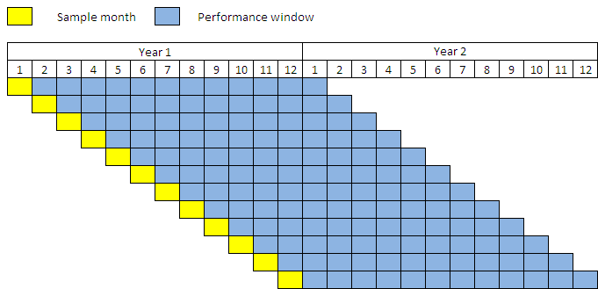
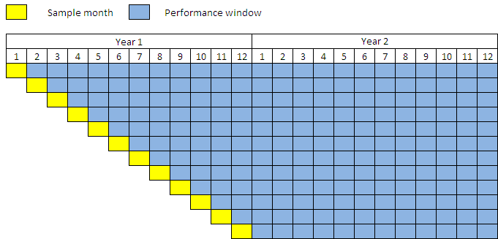
Two ways of sampling
Fixed outcome point
Staggered (rolling) outcome point
Every sample month is given the same length performance window to mature
Every sample month is given different length performance window to mature. The shortest performance window is guaranteed to be sufficient
Pros and cons?

Slide 13
Two ways of sampling
Fixed outcome point
Staggered (rolling) outcome point
Pros:
Each sample month is treated equally
It is meaningful to compare single month’s perdiction to actual
Cons:
Some performance data is wasted
Pros:
All performance data is used
The sample will have more bads, which is important for some low risk portfolios
Cons:
Older samples generate more bads but are more different than current
Be careful when comparing single month’s prediction to actual as they mean differently

Slide 14
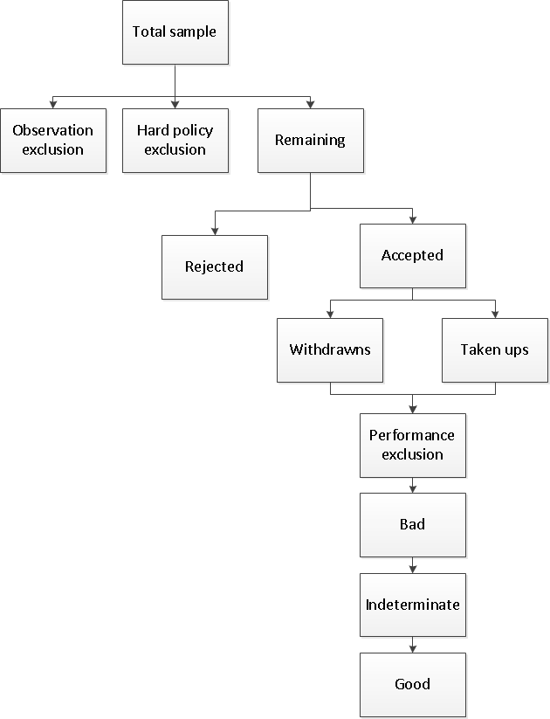
Sample structure
The structure is defined in hierarchy
Observation exclusion (OE): sub-groups where the score will not influence the decision-making. E.g., thin-file samples, discontinued products, out-of-scope loans, bad at sample point, et al
Hard policy exclusions (HE): samples that are deemed to be excluded by violating business policies. E.g., applicants below 18 years old, unemployed applicants, applicants with bad bureau records, et al
Performance exclusion (PE): no performance data or misleading performance. E.g., fraud, deceased, withdrawn, dormant, lost and stolen
Indeterminate (I): samples with not sufficient evidence to be called either bad or good. E.g., mild delinquency, limited performance data
OE and HE can be identified at sample point. PE and I depend on performance data

Slide 15
Sample structure
Observation exclusion (OE): sub-groups where the score will not influence the decision-making. E.g., thin-file samples, discontinued products, out-of-scope loans, bad at sample point, et al
Hard policy exclusions (HE): samples that are deemed to be excluded by violating business policies. E.g., applicants below 18 years old, unemployed applicants, applicants with bad bureau records, et al
Performance exclusion (PE): no performance data or misleading performance. E.g., fraud, deceased, withdrawn, dormant, lost and stolen
Indeterminate (I): samples with not sufficient evidence to be called either bad or good. E.g., mild delinquency, limited performance data
OE and HE are identified at sampling point. PE and I depend on performance data
Why do we exclude deceased? fraud? lost?

Slide 16
An example of good bad definition
Hierarchy: | Description: | Flag:
1 | Account withdrawn (never opened during performance window) | Exclusion
2 | Account opened but not drawn down in performance window | Exclusion
3 | Deceased | Exclusion
4 | Fraud (during performance window) | Exclusion
5 | Authorisation prohibited | Bad
6 | Revoked | Bad
7 | Charged-Off (Credit or Bankrupt) >= $200 | Bad
8 | Ever 90+DPD with total delinquency amount > $200 | Bad
9 | Ever 2 or more times 60+DPD with total delinquency amount > $200 | Bad
10 | Currently 60+DPD with total delinquency amount > $200 | Bad
12 | Currently 30+DPD with total delinquency amount > $200 | Indeterminate
13 | Closed Account (<6 MOB) | Indeterminate
14 | All Other Accounts | Good

Slide 17
An example of good bad definition
Rules are defined in hierarchy. If one sample hits a rule, it will not hit any rule below
Some bad definitions are not delinquency related
Hierarchy: | Description: | Flag:
1 | Account withdrawn (never opened during performance window) | Exclusion
2 | Account opened but not drawn down in performance window | Exclusion
3 | Deceased | Exclusion
4 | Fraud (during performance window) | Exclusion
5 | Authorisation prohibited | Bad
6 | Revoked | Bad
7 | Charged-Off (Credit or Bankrupt) >= $200 | Bad
8 | Ever 90+DPD with total delinquency amount > $200 | Bad
9 | Ever 2 or more times 60+DPD with total delinquency amount > $200 | Bad
10 | Currently 60+DPD with total delinquency amount > $200 | Bad
12 | Currently 30+DPD with total delinquency amount > $200 | Indeterminate
13 | Closed Account (<6 MOB) | Indeterminate
14 | All Other Accounts | Good
90+DPD is the “no brainer” standard bad definition, also consistent with Basel bad definition
Mild delinquency rules are defined based on two types: currently and ever
The set of rules will cover all the samples. The last level of hierarchy, the “good” hierarchy absorbs all the unclassified samples

Slide 18
An example of good bad definition
Rules are defined in hierarchy. If one sample hits a rule, it will not hit any rule below
Some bad definitions are not delinquency related
Hierarchy: | Description: | Flag:
1 | Account withdrawn (never opened during performance window) | Exclusion
2 | Account opened but not drawn down in performance window | Exclusion
3 | Deceased | Exclusion
4 | Fraud (during performance window) | Exclusion
5 | Authorisation prohibited | Bad
6 | Revoked | Bad
7 | Charged-Off (Credit or Bankrupt) >= $200 | Bad
8 | Ever 90+DPD with total delinquency amount > $200 | Bad
9 | Ever 2 or more times 60+DPD with total delinquency amount > $200 | Bad
10 | Currently 60+DPD with total delinquency amount > $200 | Bad
12 | Currently 30+DPD with total delinquency amount > $200 | Indeterminate
13 | Closed Account (<6 MOB) | Indeterminate
14 | All Other Accounts | Good
90+DPD is the “no brainer” standard bad definition, also consistent with Basel bad definition
Mild delinquency rules (only used in operational scorecard)
The set of rules will cover all the samples. The last level of hierarchy, the “good” hierarchy absorbs all the unclassified samples
Let’s explore these rules

Slide 19
“Ever” vs. “Current”
Performance months (window length 12 months)
Year 1 |  |  |  |  |  |  |  |  |  |  |  | Year 2
1 | 2 | 3 | 4 | 5 | 6 | 7 | 8 | 9 | 10 | 11 | 12 | 1 | 2 | 3 | 4 | 5 | 6 | 7 | 8 | 9 | 10 | 11 | 12
Sample month
Last performance month
Ever 60+DPD: If any performance month’s DPD is 60+
Currently 60+DPD: Only if the last performance month’s DPD is 60+

Slide 20
Why 90+DPD is not good enough?
If the sample cohorts mature within the ideal performance window, there is no need to have other mild delinquency bad definition. 90+DPD is sufficient to capture all bads
In real life, it is a common case that a shorter performance window is used to make the sample more relevant to current (sample freshness is also important!)
In operational scorecard development, the business has the flexibility to use other delinquency bad definitions (unlike the Basel modeling, where standard bad definition is predefined by Basel Accord)
The principal is to identify the “point of no return” (i.e., the level of delinquency at which most accounts become incurable)

Slide 21
How to identify “point of no return”
Sample month
Performance months
Observation months
Year 1 |  |  |  |  |  |  |  |  |  |  |  | Year 2
1 | 2 | 3 | 4 | 5 | 6 | 7 | 8 | 9 | 10 | 11 | 12 | 1 | 2 | 3 | 4 | 5 | 6 | 7 | 8 | 9 | 10 | 11 | 12 | 1
1. Take an extract 12 months observation period
2. Get the worst delinquency status in the performance window
3. Get the worst delinquency status in the observation window
4. Plot the roll rate chart

Slide 22
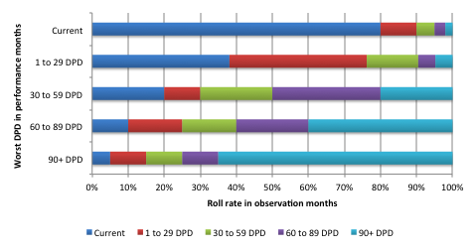
How to identify “point of no return”
Sample month
Performance months
Observation months
Year 1 |  |  |  |  |  |  |  |  |  |  |  | Year 2
1 | 2 | 3 | 4 | 5 | 6 | 7 | 8 | 9 | 10 | 11 | 12 | 1 | 2 | 3 | 4 | 5 | 6 | 7 | 8 | 9 | 10 | 11 | 12 | 1
1. Take an extract 12 months observation period
2. Get the worst delinquency status in the performance window
3. Get the worst delinquency status in the observation window
4. Plot the roll rate chart
More than 60% of the accounts that reach 90+DPD in performance window stay in the bucket in the next 12 months, which means 90+DPD is a reasonable “point of no return”

Slide 23
How to identify “indeterminate”
Indeterminates are those that have not sufficient performance history for classification or that have some mild delinquency with roll rates neither low enough to be classified as good, nor high enough to be bad
Indeterminate is a concept only related to modeling. By removing the sample in gray area, a model can better separate black and white.
There is no “indeterminate” to the business. All indeterminates are TTD data and should be included for benchmarks, validation and cut-off analysis
It is dangerous to have a large size of indeterminate (e.g., >10%). Some advocate to eliminate the “indeterminate” category

Slide 24
How to identify “indeterminate”
Indeterminates are those that have not sufficient performance history for classification or that have some mild delinquency with roll rates neither low enough to be classified as good, nor high enough to be bad
Indeterminate is a concept only related to modeling. By removing the sample in gray area, a model can better separate black and white.
There is no “indeterminate” to the business. All indeterminates are TTD data and should be included for benchmarks, validation and cut-off analysis
It is dangerous to have a large size of indeterminate (e.g., >10%). Some advocate to eliminate the “indeterminate” category
“Worst DPD 60 to 89” can be classified as “indeterminate” given the fact that only 40% rolls to 90+DPD

Slide 25
Segmentation
In some cases, instead of using one model on the entire population, several models are built on sub-populations. The split of the entire population is called segmentation
Main driver factors to segmentation:
Business requirement: different risk appetite thus different strategies and cut-offs. E.g., split by products
Different data is available. E.g., primary vs. non-primary
Different treatments. E.g., current clean vs. current dirty
Different risk signals / better model fit. E.g., young vs. old

Slide 26
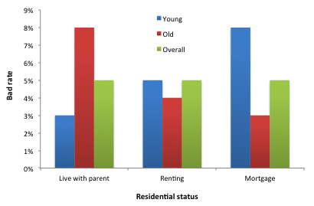
Segmentation
In some cases, instead of using one model on the entire population, several models are built on sub-populations. The split of the entire population is called segmentation
Main driver factors to segmentation:
Business requirement: different risk appetite thus different strategies and cut-offs. E.g., split by products
Different data is available. E.g., primary vs. non-primary
Different treatments. E.g., current clean vs. current dirty
Different risk signals / better model fit. E.g., young vs. old

Slide 27
Segmentation
In some cases, instead of using one model on the entire population, several models are built on sub-populations. The split of the entire population is called segmentation
Main driver factors to segmentation:
Business requirement: different risk appetite thus different strategies and cut-offs. E.g., split by products
Different data is available. E.g., primary vs. non-primary
Different treatments. E.g., current clean vs. current dirty
Different risk signals / better model fit. E.g., young vs. old
Overall, “residential status” is not a predictive variable

Slide 28
Segmentation
In some cases, instead of using one model on the entire population, several models are built on sub-populations. The split of the entire population is called segmentation
Main driver factors to segmentation:
Business requirement: different risk appetite thus different strategies and cut-offs. E.g., split by products
Different data is available. E.g., primary vs. non-primary
Different treatments. E.g., current clean vs. current dirty
Different risk signals / better model fit. E.g., young vs. old
Overall, “residential status” is not a predictive variable
On young segment, “Living with parent” has lowest risk and “On mortgage” has the highest risk

Slide 29
Segmentation
In some cases, instead of using one model on the entire population, several models are built on sub-populations. The split of the entire population is called segmentation
Main driver factors to segmentation:
Business requirement: different risk appetite thus different strategies and cut-offs. E.g., split by products
Different data is available. E.g., primary vs. non-primary
Different treatments. E.g., current clean vs. current dirty
Different risk signals / better model fit. E.g., young vs. old
Overall, “residential status” is not a predictive variable
On young segment, “Living with parent” has lowest risk and “On mortgage” has the highest risk
On old segment, the risk signal is completely reversed

Slide 30
How to choose splitting criteria
Manual selection (with the help of business knowledge)
Clustering analysis
Chi-square automatic interaction (CHAID) analysis
Quick & dirty model fit: quantify the most beneficial split

Slide 31
Good segmentation split
Have enough goods and bads to ensure statistical significant models
Population split is stable over time (Check monthly volumes)
Help the business to design different risk appetites for different sub-populations
Have significant meaningful performance up-lift (Attention: Gini may not be sufficient to decide which split produces more benefit!)
Put a chart here!

